Slide 1


Intermediate Python
AI Integration & API Development

Slide 2
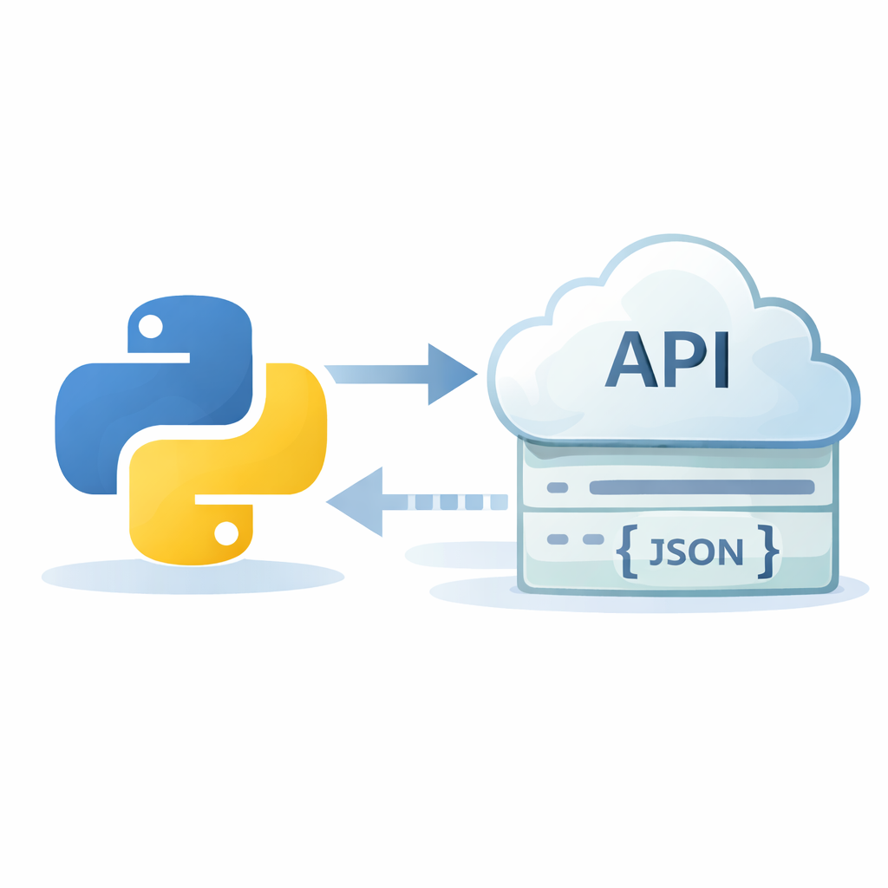
API Integration with Python
Python applications can communicate with external services using HTTP APIs.
APIs allow software systems to exchange data
Python uses the requests library for HTTP calls
Common request types: GET, POST, PUT, DELETE
APIs typically return JSON data
Error handling is essential for reliability
Notes:
Explain that APIs are how modern apps connect to services like OpenAI, weather data, payment gateways, and maps. Emphasize that JSON is the most common data format.

Slide 3
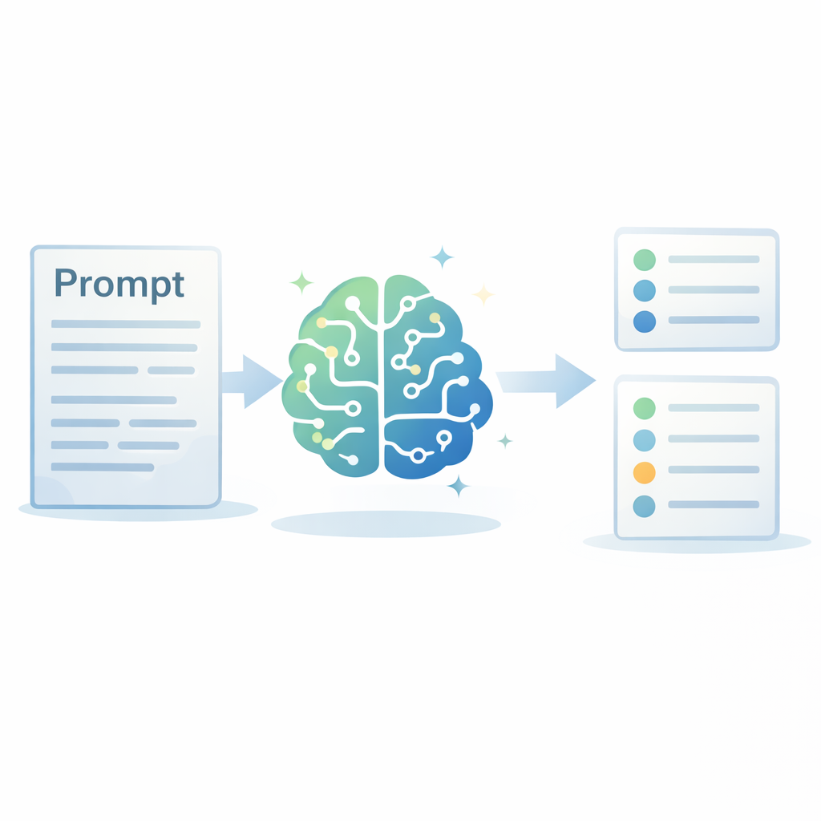
Prompt Engineering Basics
Prompt engineering controls how AI models understand and respond to user requests.
A prompt is the instruction given to an AI model
Clear structure improves response quality
Include constraints and output format (RCCT)
Provide context and role instructions
Iterative refinement leads to better results
Notes:
Explain that prompt engineering is like giving instructions to a junior assistant — the clearer the instructions, the better the output.

Slide 4
Flask vs Streamlit vs FastAPI
Different Python frameworks serve different deployment needs.
Flask: lightweight web framework for general apps
FastAPI: modern API framework with auto-docs
Streamlit: fastest way to build data apps
FastAPI is best for backend AI services
Streamlit is ideal for quick UI demos
Notes:
Compare frameworks using real examples:
Flask → traditional web app
FastAPI → AI backend service
Streamlit → rapid prototype UI

Slide 5
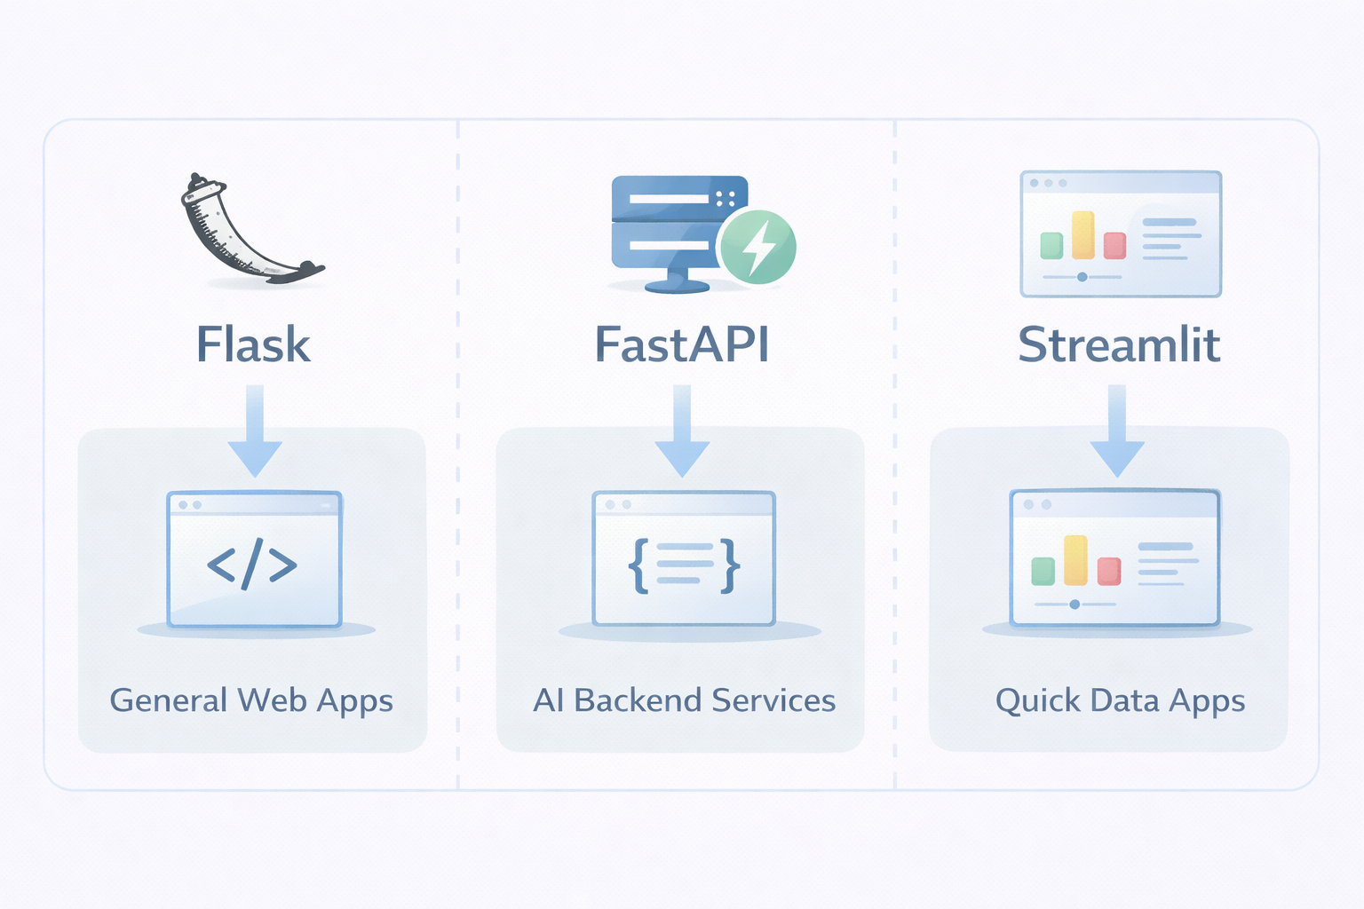

Slide 6

Secure API Keys
API keys must always be protected to prevent misuse.
API keys authenticate access to services
Never hardcode keys in source code
Use environment variables instead
Store keys in .env files
Never commit secrets to GitHub
Notes:
Explain real risks:
Stolen keys can incur huge costs
Keys should only exist on the server side
Always use .env and .gitignore

Slide 7
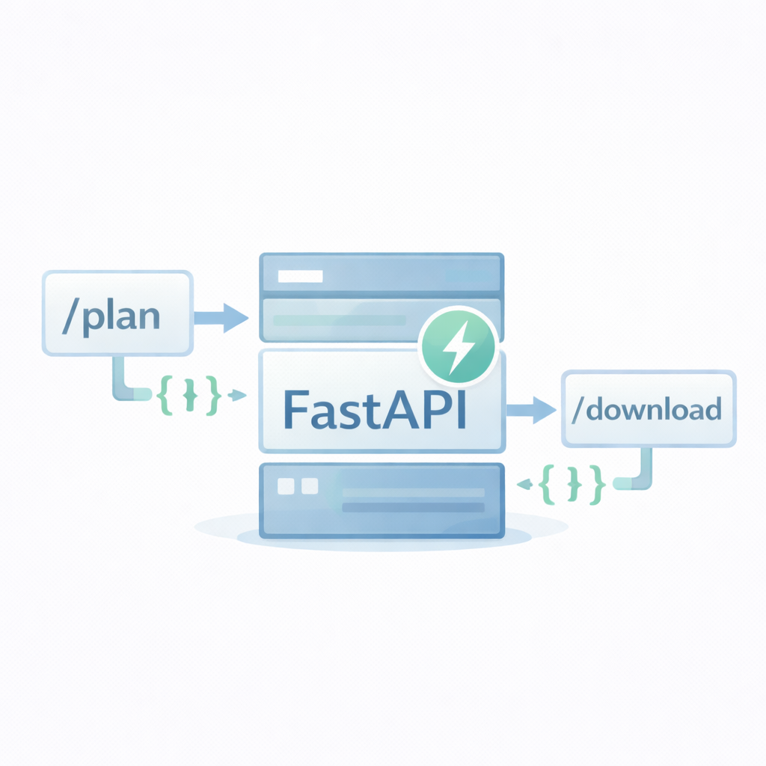
FastAPI Endpoints
FastAPI allows building high-performance REST APIs quickly.
Endpoints define API routes
Use decorators like @app.get() and @app.post()
Automatic data validation via Pydantic
Supports async operations
Extremely fast and scalable
Notes:
Explain that endpoints are like “doors” to an application — each route performs a specific task.

Slide 8
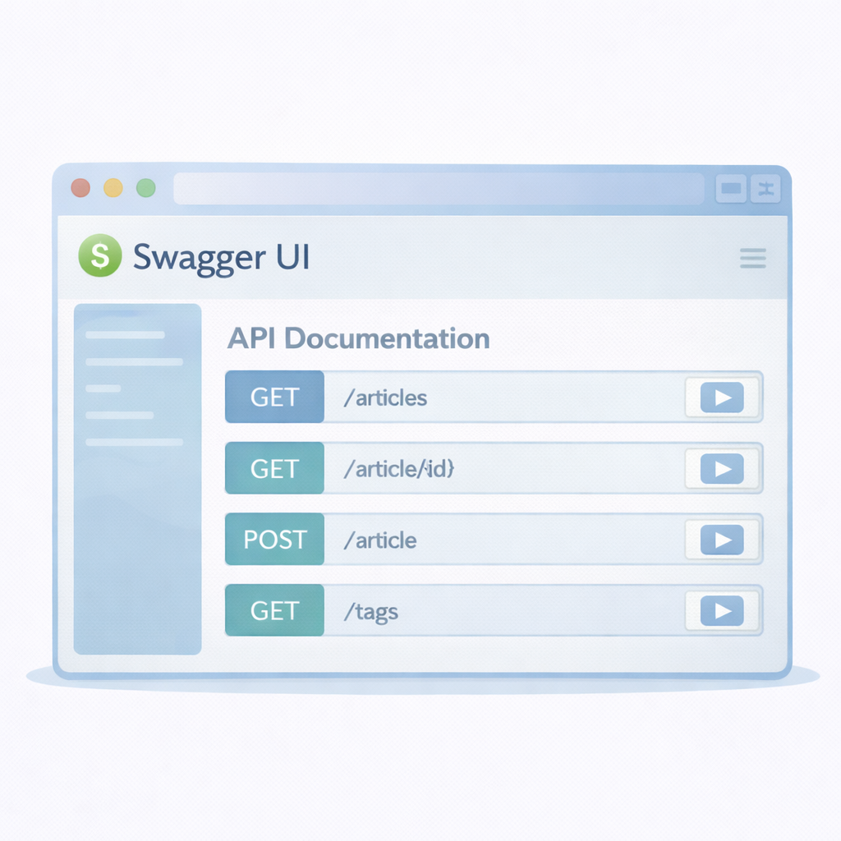
Swagger UI Documentation
FastAPI automatically generates interactive API documentation.
Available at /docs by default
Shows all API endpoints visually
Allows testing APIs directly
Displays request/response schemas
Speeds up development and debugging
Notes:
Highlight that this is one of FastAPI’s biggest advantages — instant documentation without extra coding.

